Slide 1
Database Design for Software Architects
Jeremiah Peschka
jeremiah.peschka@gmail.com
A Legitimate Business, LLC

Slide 2
Our Agenda
Thinking in layers
Logical Design
Implementing a logical model
Even more layers
YAGNI
BDUF

Slide 3
Why are we here?

Slide 4
Databases, like diamonds, are forever
They’re also really expensive.
And if you mess up, it’s only going to get more expensive.
Design early and avoid costly mistakes later.

Slide 5
How do architects think?

Slide 6
Architecture, eh?
Architecture is a shared understanding of the components in a system and how they interact.
These components are usually structured in layers.
Our job is to come up with an architecture for the database.

Slide 7
Process
We want to work from abstract to concrete.
  Define high level concepts.
  Map concepts to our chosen implementation.
  Rinse. Repeat.
Along the way, we take advantage of the technology we have.
And we probably argue a lot, too.

Slide 8
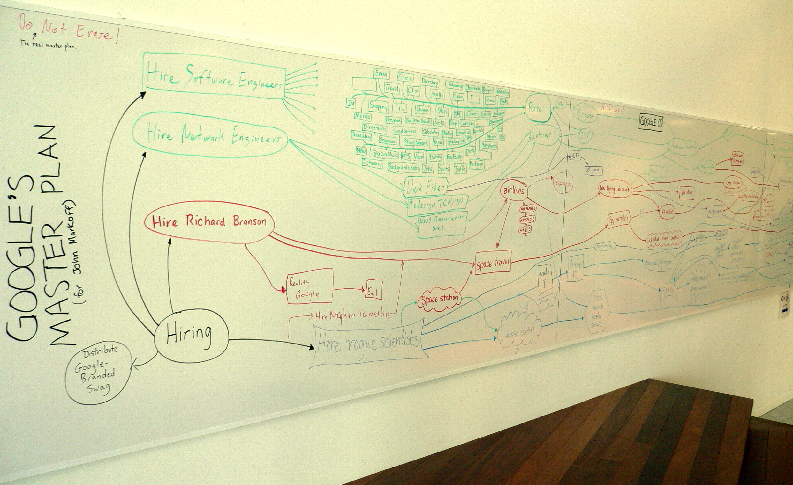
Abstractions!
Google’s Master Plan by Steve Jurvetson is licensed under CC BY 2.0

Slide 9
Logical design – the first layer
Our database expressed as general concepts.
This is maps closely with business terms.
You might call it “boxes and arrows”.
Frequently done using UML or database specific tools.

Slide 10
Step 1: the break down
We split the system into entities and their attributes.
Stay broad at this point in design.
  A customer has many orders.
  An order has one or more line items.

Slide 11
Entities are not tables
This is the logical design.
Worry about physical implementation later.

Slide 12
Step 2: the dependency graph
As we map out entities, we slowly make a dependency graph.
  Describes which entities depend on the other.
  The dependency graph helps guide implementation.

Slide 13
An Example!

Slide 14
We have an online store
We sell stuff.
Customers buy stuff.
Customers can have stuff in their orders.
Customers can ship stuff to different places.

Slide 15
You might think…
Products
Customers
Addresses
Payment Methods
Orders
Tax
Info

Slide 16
But what if…
A customer changes their address?
  How do we know we shipped to the right address?
  How do we know we have the right billing address?
Or their credit card number?
Or a product’s description changes?
Or state tax levels change?

Slide 17
Our model isn’t wrong, but…
It may not be right, either.
We need to understand more about how the business works with these entities.

Slide 18
It might really look like…
Order Addresses
Customers
Orders
Line Items
Payment Methods
Tax
Info
Addresses
Payment
Info

Slide 19
The logical design is a guide
You don’t have to implement the database this way.
  This could be two JSON documents.
  It could be 23 tables.
During the logical design process, we don’t worry about the implementation.
That’s a problem for future us.

Slide 20
Implementing a Logical Model

Slide 21
This is where we do the dirty work
The logical model starts getting mapped to the persistence layer.
We make decisions about how we’ll save and read data.
We’ll be thinking about:
  Tables
  Data types
  Constraints
  Keys

Slide 22
A table is a collection of queryable objects.

Slide 23
In other words, one row should not hold two things.

Slide 24
Normalize first, “optimize” later
It’s easier to denormalize a properly normalized database.
It’s really hard to fix a denormalized database.
My favorite reference for this is Louis Davidson’s Pro Relational Database Design and Implementation

Slide 25
What about data types?
Knowing our business rules helps us pick the right data type.
  Only storing the time something happens? Use TIME.
  Only storing the date? Use DATE.
Data types are where we also need to think about the future.
  Not the “what’s for lunch” future.
  This is the “what’s for lunch in 5 years” future.

Slide 26
What’s for lunch in 5 years?
Are you running out of integers for your primary key?
Are you enabling collaborative features across multiple time zones and you realized that your DATETIMEs don’t support time zones?
Are you expanding into China and you’ve realized that your tables only have VARCHAR values?
Think through these kinds of problems and ask the business really difficult questions.
They’ll thank you, I promise.

Slide 27
Data types provide rules
Using the right data types gives you a set of rules.
  TINYINT only allows 0 – 255.
  That is a safe bet for an age column.
These rules can be inferred by anyone.
Getting data types right makes a database easier to understand.

Slide 28
Even more rules!
Primary keys and unique constraints provide additional rules.
Quick reminder:
  Unique constraints are all the unique ways to identify a single row in a table.
  A primary key is, usually, the narrowest unique constraint.
  Sometimes the primary key is artificial.
  Don’t confuse primary keys with clustering keys at this stage.
Make sure you match these rules and test them.
Notes:
Funny story to tell here – unique constraint on first, middle initial, last

Slide 29
Check constraints
“But my application can check the data! Duplicating code and work is a really Bad Thing™!”
Data can come from multiple places.
  Users within the application.
  Administrative users in a back office application.
  Upstream systems.
  Routine maintenance.
  One time data modifications.

Slide 30
Check constraints
Make sure the data always fits the rules.
Create a more complex definition for acceptable values for a column.
  Data types are broad.
  Unique constraints say “only 1 or 0 of this value”
  Check constraints say “value must match this pattern”
We can even use check constraints to validate conditions across multiple columns in the same row.

Slide 31
Foreign Keys
These help us design relationships between two tables.
Foreign keys can only reference unique indexes or primary keys.
  Which is good, because we need to point back to a unique row.
  But it’s still good to remember.

Slide 32
Constraints can make things slower
Bulk imports can get noticeably slower.
It is possible to disable constraints for the load, but…
  They need to be manually enabled.
  Once enabled, they aren’t automatically checked.
  You’ll need to make sure you check that the data is valid after you re-enable the constraints and have a plan to deal with bad data.
This isn’t just for check constraints, this also applies to foreign keys.

Slide 33
A note about weird data types

Slide 34
JSON and XML
Allegedly, “all columns must be atomic”.
That means each column only has one thing.
What about XML and JSON (starting with SQL Server 2016)?
Technically these can store many things.

Slide 35
JSON and XML as a single value
These data types are most helpful when used as a single value.
When used as an object with many values:
  Querying becomes very complex.
  Very CPU intensive.
  Difficult to query.
May be capturing an original value for historical reasons.
  API message call.
  Record from an upstream system.
  EDI system.

Slide 36
Even more layers
Databases are like 7 layer bean dip

Slide 37
Tables are the base layer
This is the lowest level of data access.
We should build better abstractions on top of tables.
If you want a metaphor:
  Tables are your objects.
  Let’s design some abstractions on top of those objects.

Slide 38
A disclaimer!
I’m now going to talk about stored procedures and views.
You could also use similar encapsulation in your application.
Whatever.
This is about providing additional abstractions on top of our database to provide better composability.

Slide 39
Map DB Views to Application Views
Users interact with information by either viewing it or changing it.
Database views can be easily consumed by the application.
Instead of having to know how the tables are structured, our developers simply need to know to query Sales.OrdersWithLineItems

Slide 40
Views – Pros and Cons
Upsides of views:
  They act just like tables.
  We can hide security in the views.
  We can tune data access in the view.
Downsides of views
  Complex logic may be difficult implement.
  They can cause query performance problems on some platforms.
  Data access through views can be painful.

Slide 41
Map Stored Procedures to Application Actions
A stored procedure is multiple statements bundled together.
We can build more complex logic into a procedure.
Complex activity, that’s entirely data related, can be maintained and tuned in a single location – the procedure.

Slide 42
Stored Procedures – Pros and Cons
What’s good about stored procedures:
  We can add security inside the procedure.
  Code can be tuned without deploying application changes.
  Complex data logic can be embedded with the data.
What’s bad about stored procedures:
  Totally not composable.
  Nested stored procedures can lead to subtle bugs that are difficult to diagnose.

Slide 43
Views and Stored Procedures as an API
These are just another layer on top of the database.
Views and procedures can bring the implementation closer to the logical model.
Your mileage may vary, depending on platform and use case.
These are important tools as we design our application.

Slide 44
YAGNI

Slide 45
You Ain’t Gonna Need It - Refresher
This comes from extreme programming.
It’s the idea that we shouldn’t add functionality until it’s deemed necessary.
Seems pretty good, right?

Slide 46
Usually YAGNI is a great idea
Databases are forever. Don’t build crazy things unless you need them.
On the flip side, databases do mean we have to ask some difficult questions up front.
  Some changes are hard.
  Ask the business long range questions right away.
Most important if we might have to change physical data storage later.
  Supporting international data after several years.
  Adding time zone support to temporal data.

Slide 47
In support of YAGNI
No decision is permanent.
Some decisions are just more expensive than others.

Slide 48
Big Design Up Front?

Slide 49
BDUF – the design is perfect up front
Or, at least, the design is complete for our purposes.
Completing the logical design in advance can be desirable.
This is typically not seen as desirable.
  It’s difficult to see all the needs of software in advance.
  Requirements can change mid-project.

Slide 50
Design features up front
Treat each feature or addition as a product.
Ask lots of difficult questions.
Get the logical design in place in advance.
  You may need to make changes to physical implementation.
  You may need to make smaller changes to validation rules.
  High level entities probably will not change.

Slide 51
Wrapping Up

Slide 52
We talked through…
Thinking in layers
Logical Design
Implementing a logical model
Even more layers
YAGNI
BDUF

Slide 53
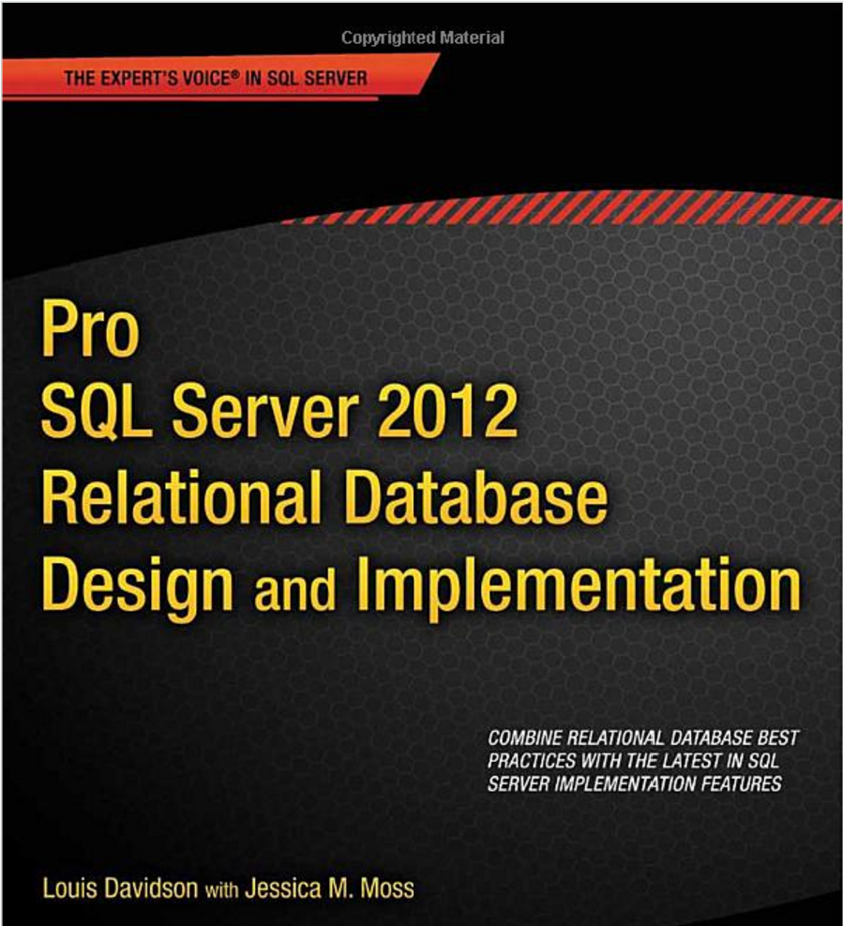
Curious to learn more?
I recommend Louis Davidson’s “Pro SQL Server 2012 Relational Database Design and Implementation”
Totally stole that picture from Amazon, BTW

